Slide 1
Advanced Programming
Module Project
Module: Web Development Using Platforms
Start Date : 26 October 2022
End Date : 23 November 2022
Submission Date : 23 November 2022
Learner Name : Wildan Luqmanul Hakim
Enrollment ID : BDSE04-0322/STTB
Presentation Date :

Slide 2
Contents
Contents
S. No. | Description
01 | List of software used
02 | OO Paradigm
03 | Class Relationships
04 | Class Diagram
05 | Developing Triple A portlet
06 | Customer Management Portlet
07 | Design Patterns
08 | Creational Design Patterns
09 | Structural Design Patterns
10 | Behavioural Design Patterns

Slide 3
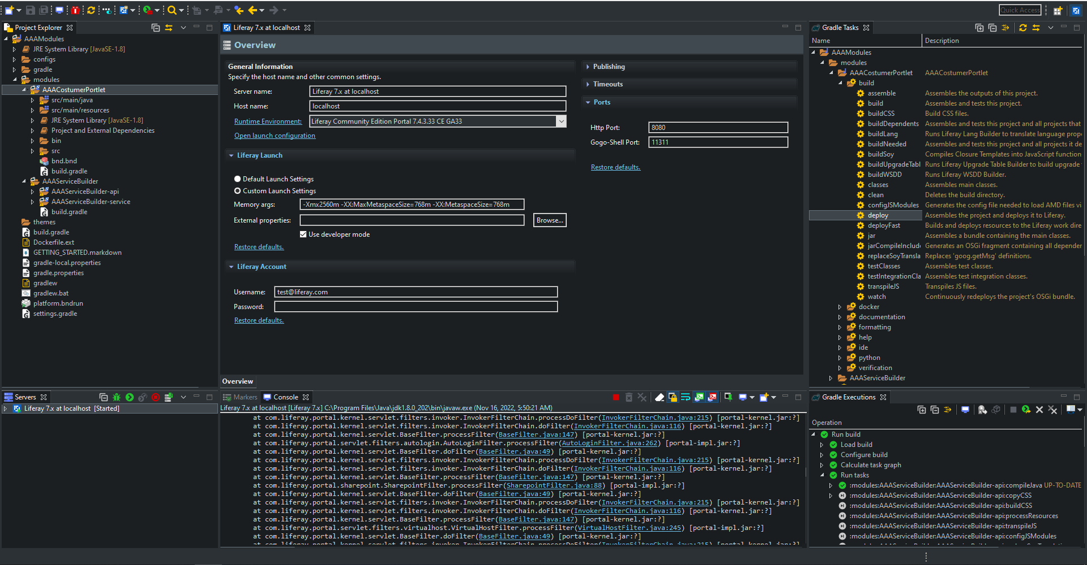
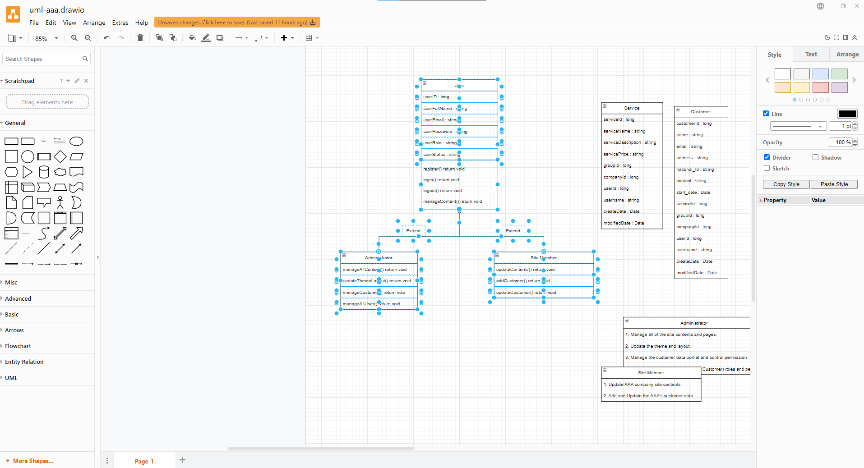
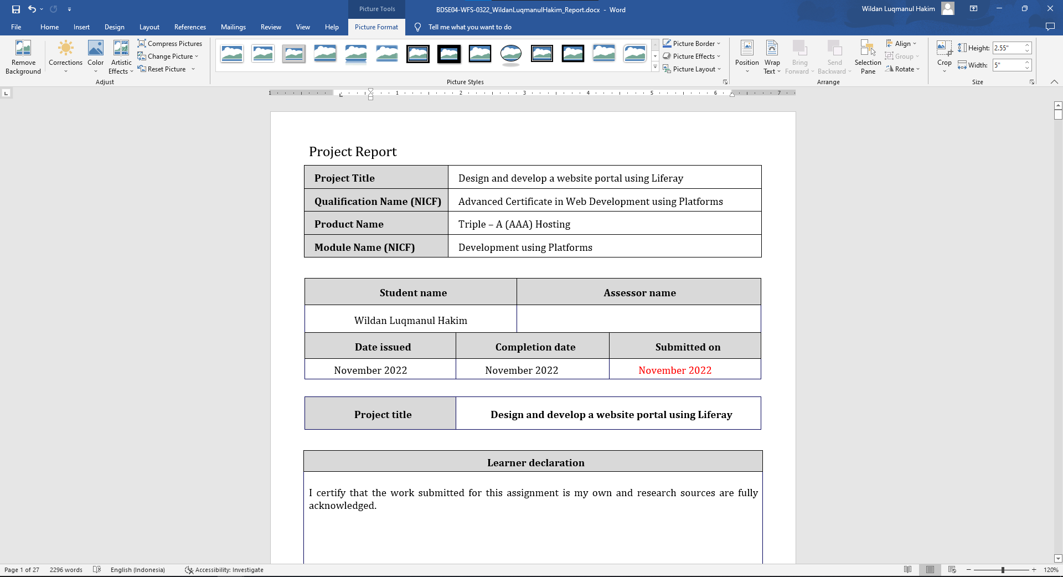
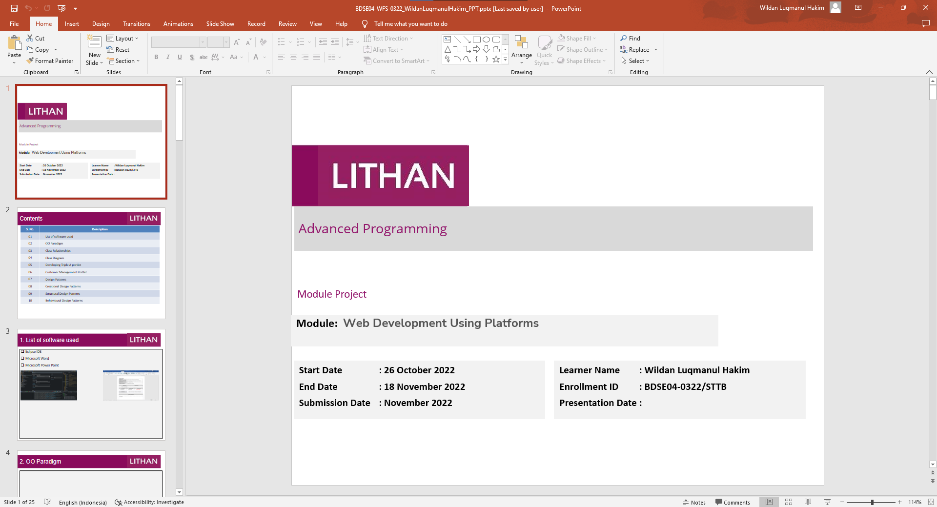
1. List of software used
Liferay IDE
Microsoft Word
Microsoft Power Point
Diagram.net
Diagram.net
Microsoft Word
Microsoft Power Point

Slide 4
2. OO Paradigm
Object Oriented Programming
Object-oriented programming (OOP) is a style of programming characterized by the identification of classes of objects closely linked to the methods (functions) with which they are associated.
Main Structure
Classes are responsible for collecting procedures/functions and variables in one place. Class is a blueprint of an object or template for creating objects. Class represented object that will be created. So naming Class should be appropriate for object.
Objects are instances of a class created with specifically defined data. Objects can correspond to real-world objects or an abstract entity. When class is defined initially, the description is the only object that is defined.
Attributes are part of a class that is still closely related to that class. Attributes can also be referred to as properties or properties of a class.
Method role describes how an attribute act. The role in question is in the form of behavior that can be described by a method. Additionally, the subroutines contained in an object are called instance methods. Programmers use methods for reusability or keeping functionality encapsulated inside one object at a time.

Slide 5
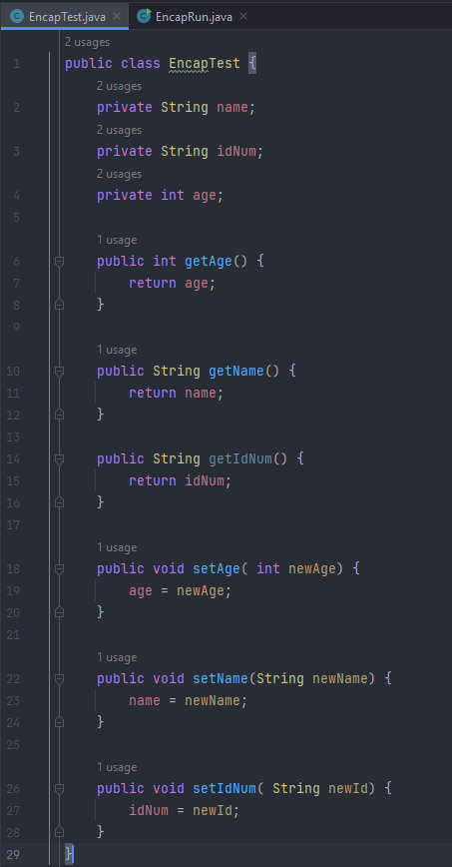
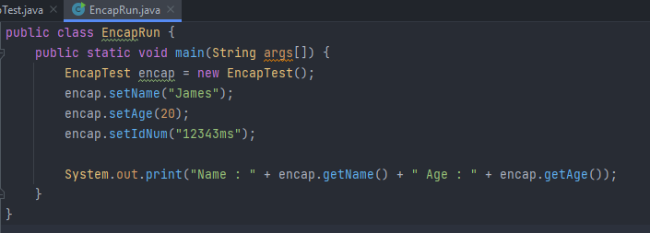
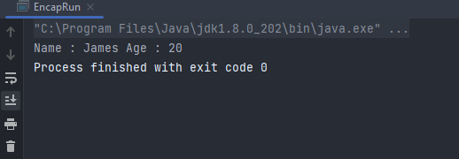
2. OO Paradigm
Characteristics of Object Oriented Programming Paradigm
Encapsulation Encapsulation is the wrapping of data or hiding personal data from an object so that it cannot be accessed from other objects.
Result:

Slide 6
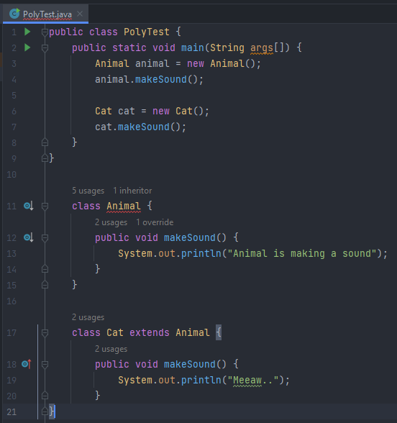
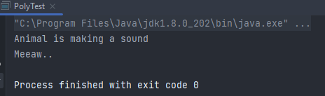
2. OO Paradigm
Characteristics of Object Oriented Programming Paradigm
Polymorphism Polymorphism (polymorphism) consists of two syllables, poly means many and morphism comes from the word morph means form.
Result:

Slide 7
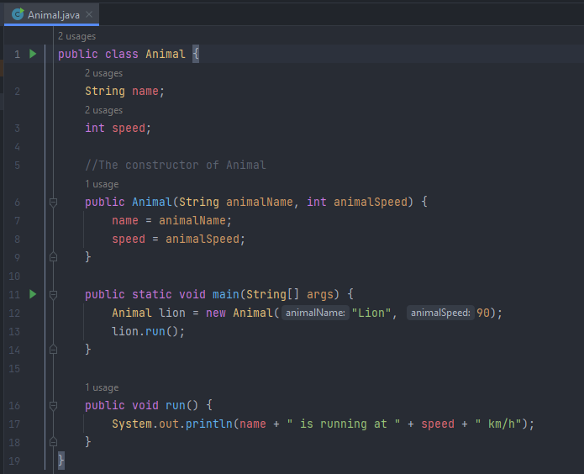
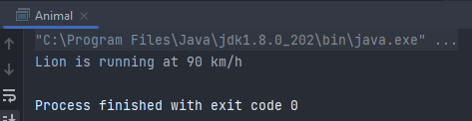
2. OO Paradigm
Characteristics of Object Oriented Programming Paradigm
Constructor Constructor is a special method that is used for initialization when creating an object. The constructor is called as soon as the new object is created.
Result:

Slide 8
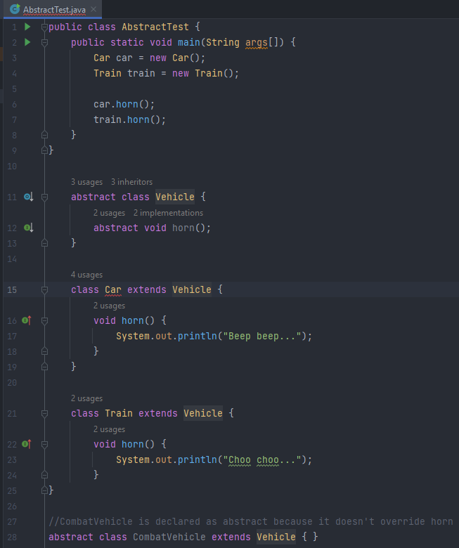
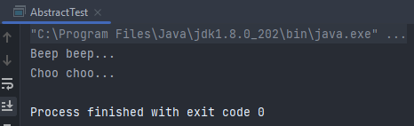
2. OO Paradigm
Characteristics of Object Oriented Programming Paradigm
Abstract Abstract is a declaration without providing details on what is declared. Abstract can be implemented in classes or methods using the abstract keyword.
Result:

Slide 9
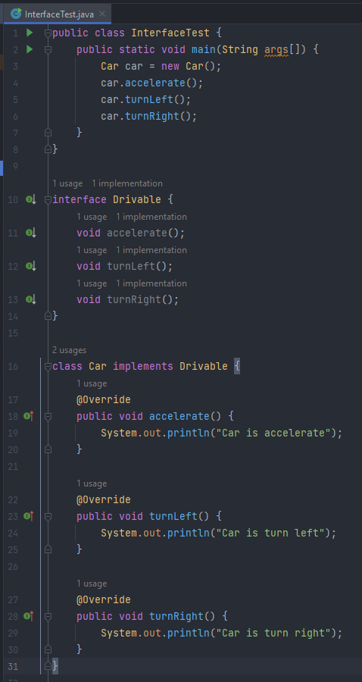
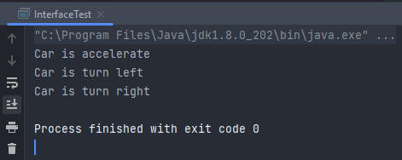
2. OO Paradigm
Characteristics of Object Oriented Programming Paradigm
Interface The interface is a class-like form in which it consists of a collection of empty methods and constants. Interfaces cannot be made objects but can only be implemented
Result:

Slide 10
3. Class Relationships
Class Relationship
In a class diagram, all classes are linked with each other by proper relationships. These links aid the user in understanding the connection between different entities thoroughly. However, due to the slight similarities, many often have trouble understanding the different class diagram relationships.
Inheritence
Association
Composition

Slide 11
3. Class Relationships
Inheritence : Administrators, Site Members, and customer classes have common variables and methods, they all use inheritance from the User, a new super class with generic variables and methods.
Association : Administrators can only manage customers and site members, and site members can only handle customers, so the relationship between administrators and customers, administrators and site members, and site members and customers is unidirectional.
Composition : It is used between the Customer and Service classes because they have a relationship, which means that when the Service class changes something, the Customer class also changes.

Slide 12
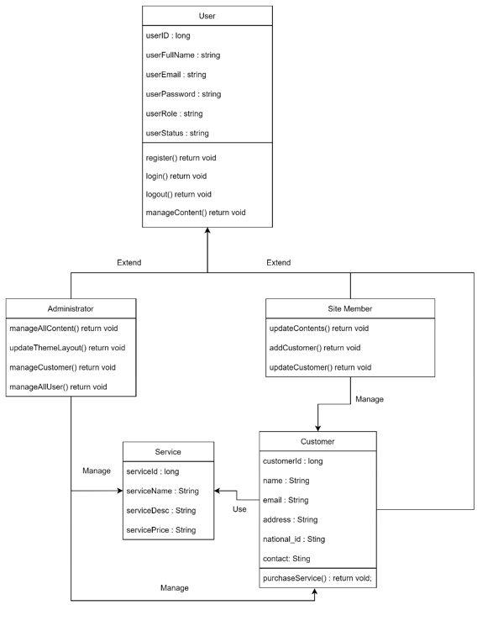
4. Class Diagram
Class Diagram based on project scenario using UML

Slide 13
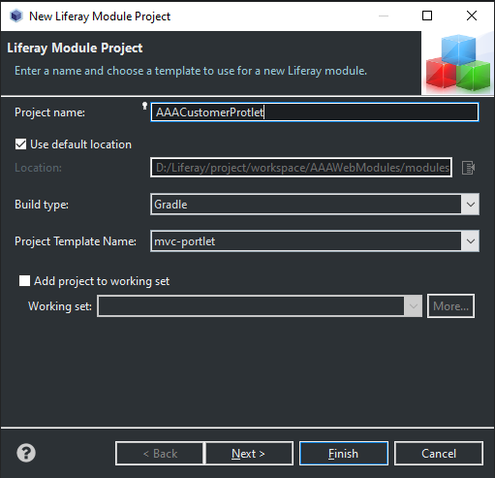
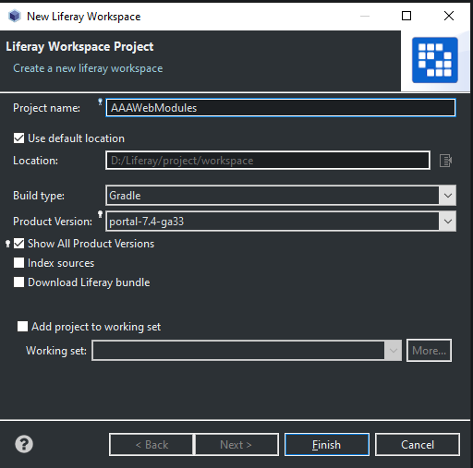
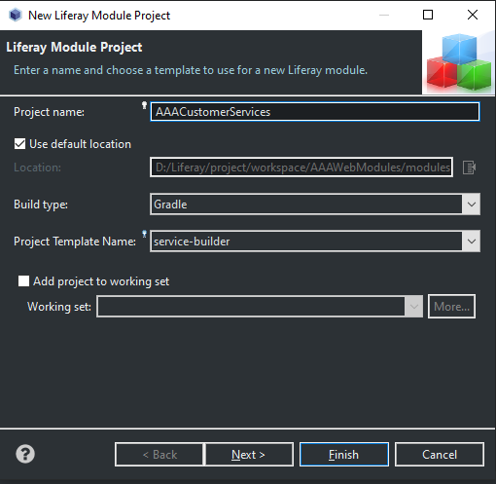
5. Developing Triple A Portlet
Create Portlet
Create Module
Create Service Builder

Slide 14

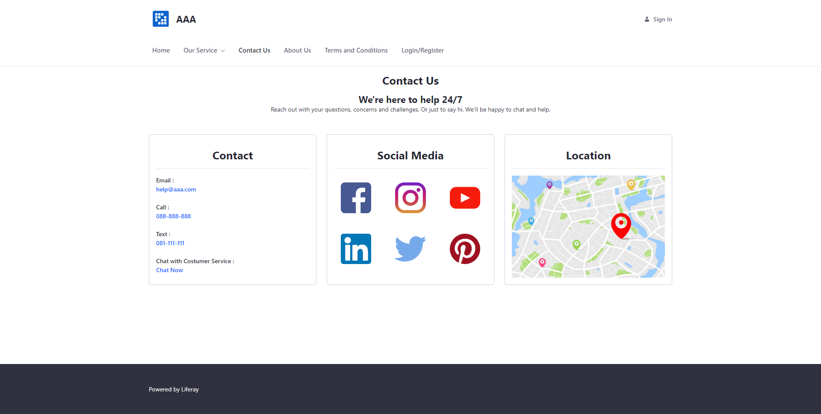
5. Developing Triple A Portlet
Home Page
Contact Us Page

Slide 15
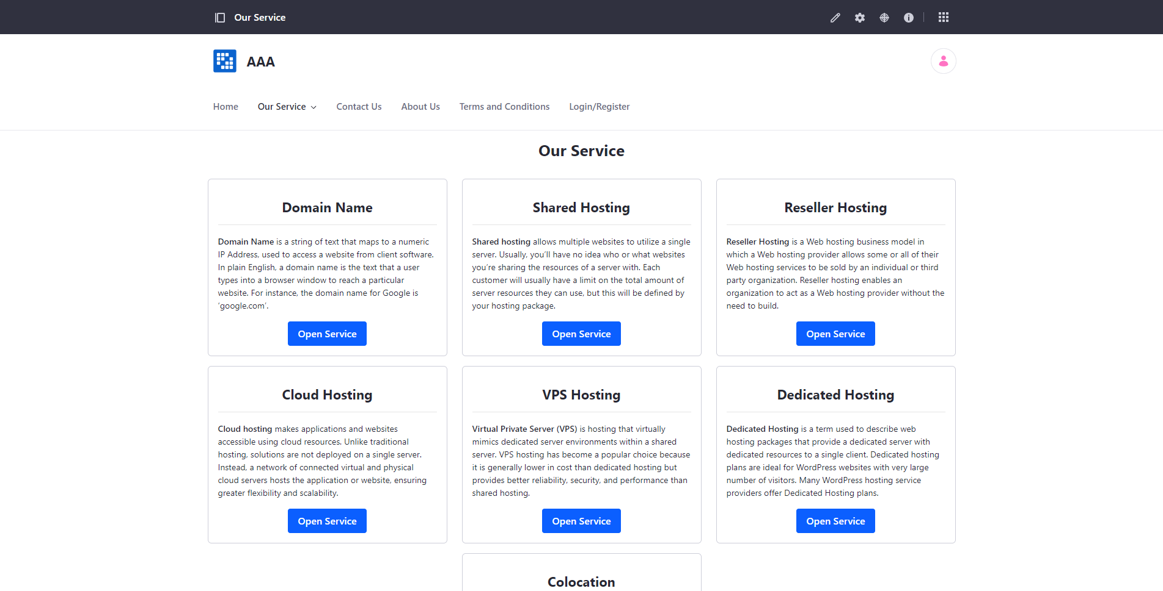
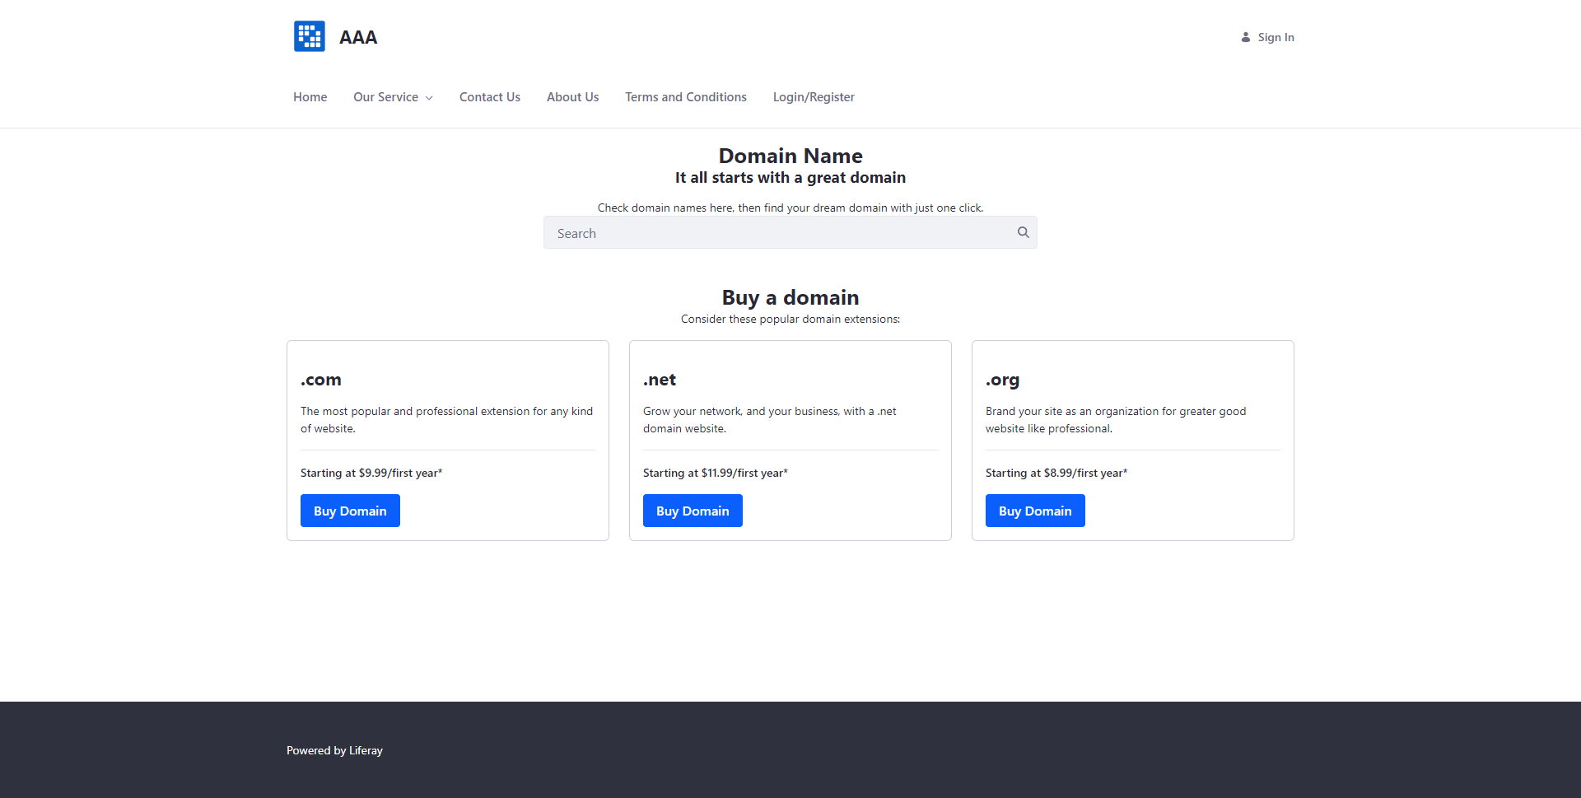
5. Developing Triple A Portlet
Our Service Page
Domain Service Page

Slide 16
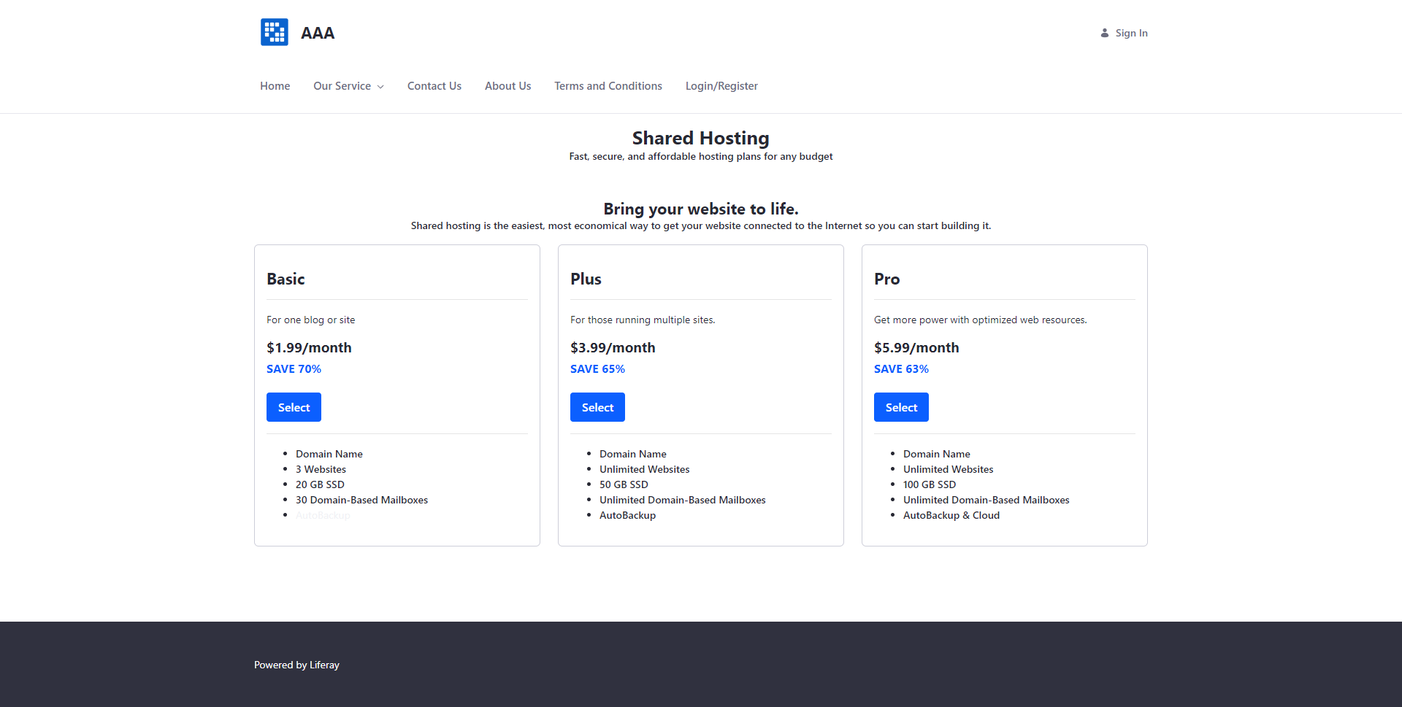
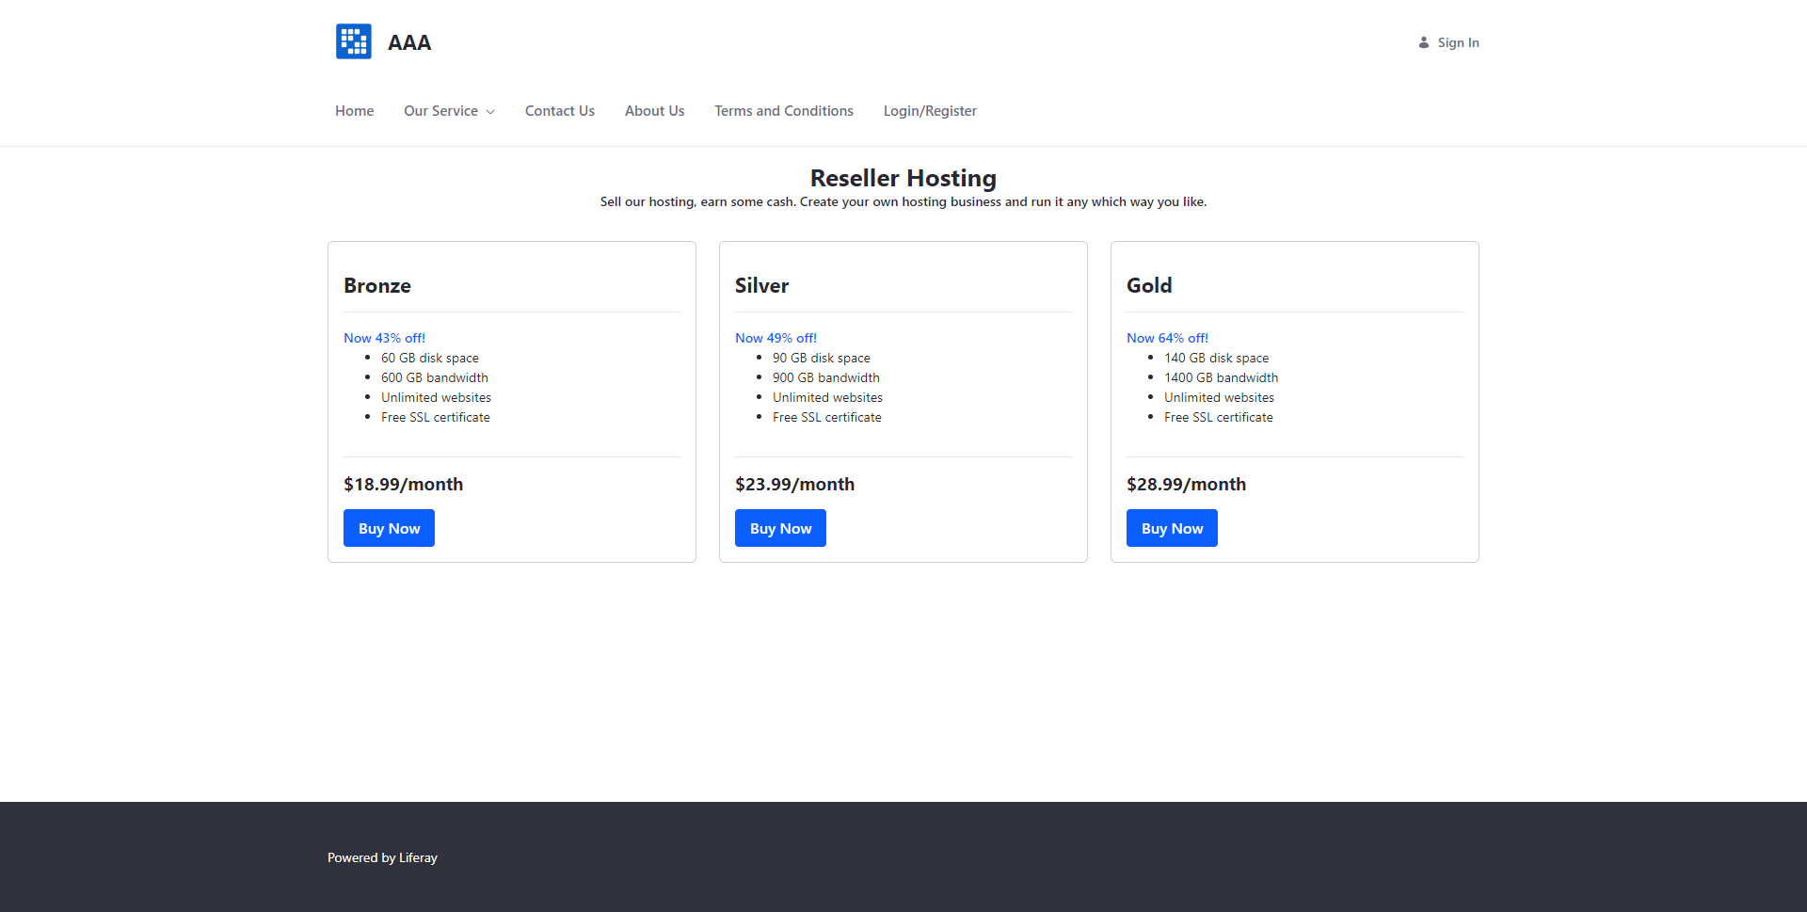
5. Developing Triple A Portlet
Shared Hosting Service Page
Reseller Hosting Service Page

Slide 17
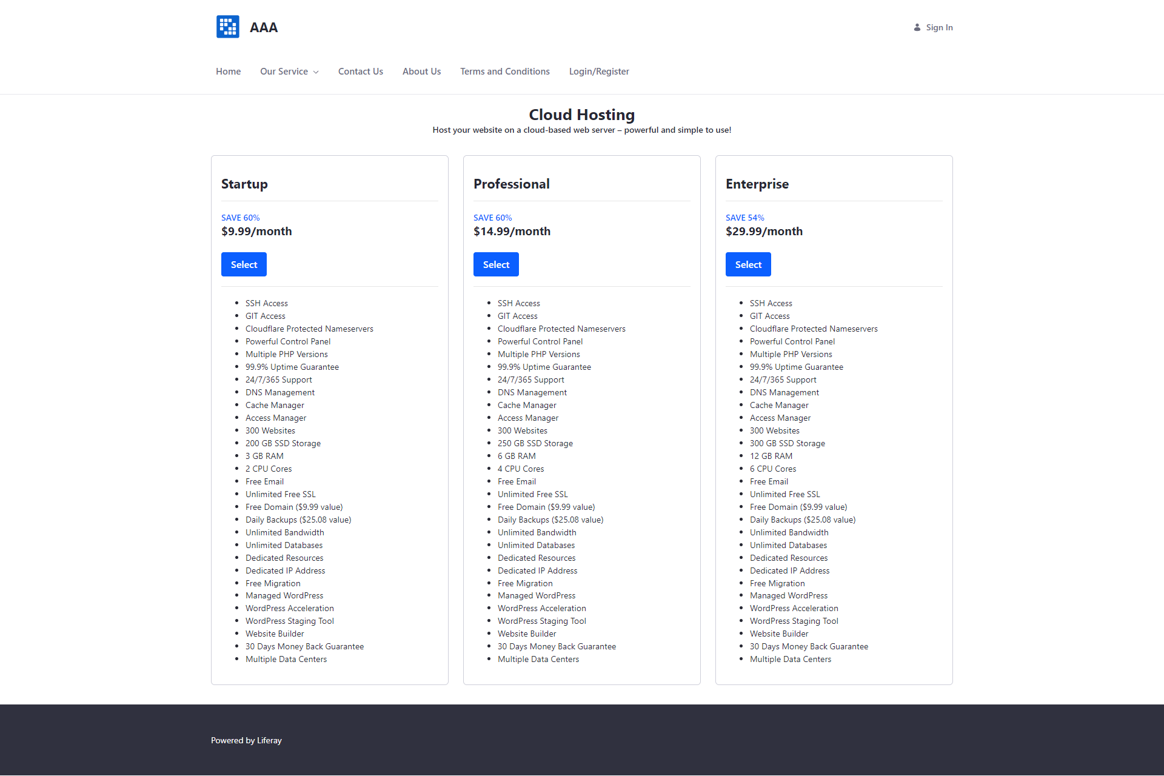
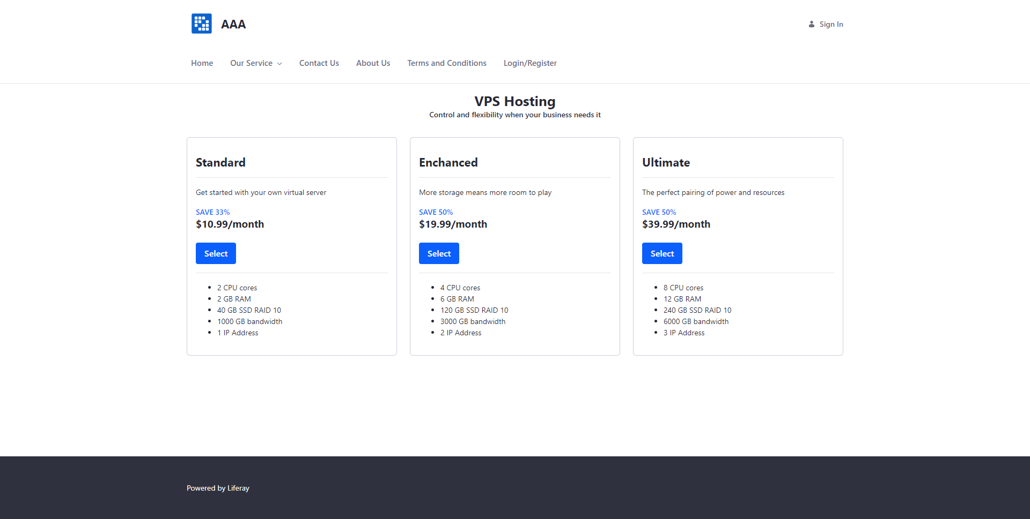
5. Developing Triple A Portlet
Cloud Hosting Service Page
VPS Hosting Service Page

Slide 18
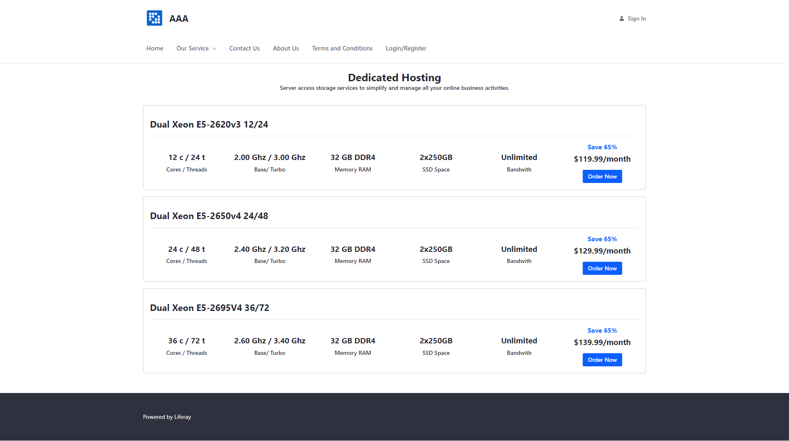
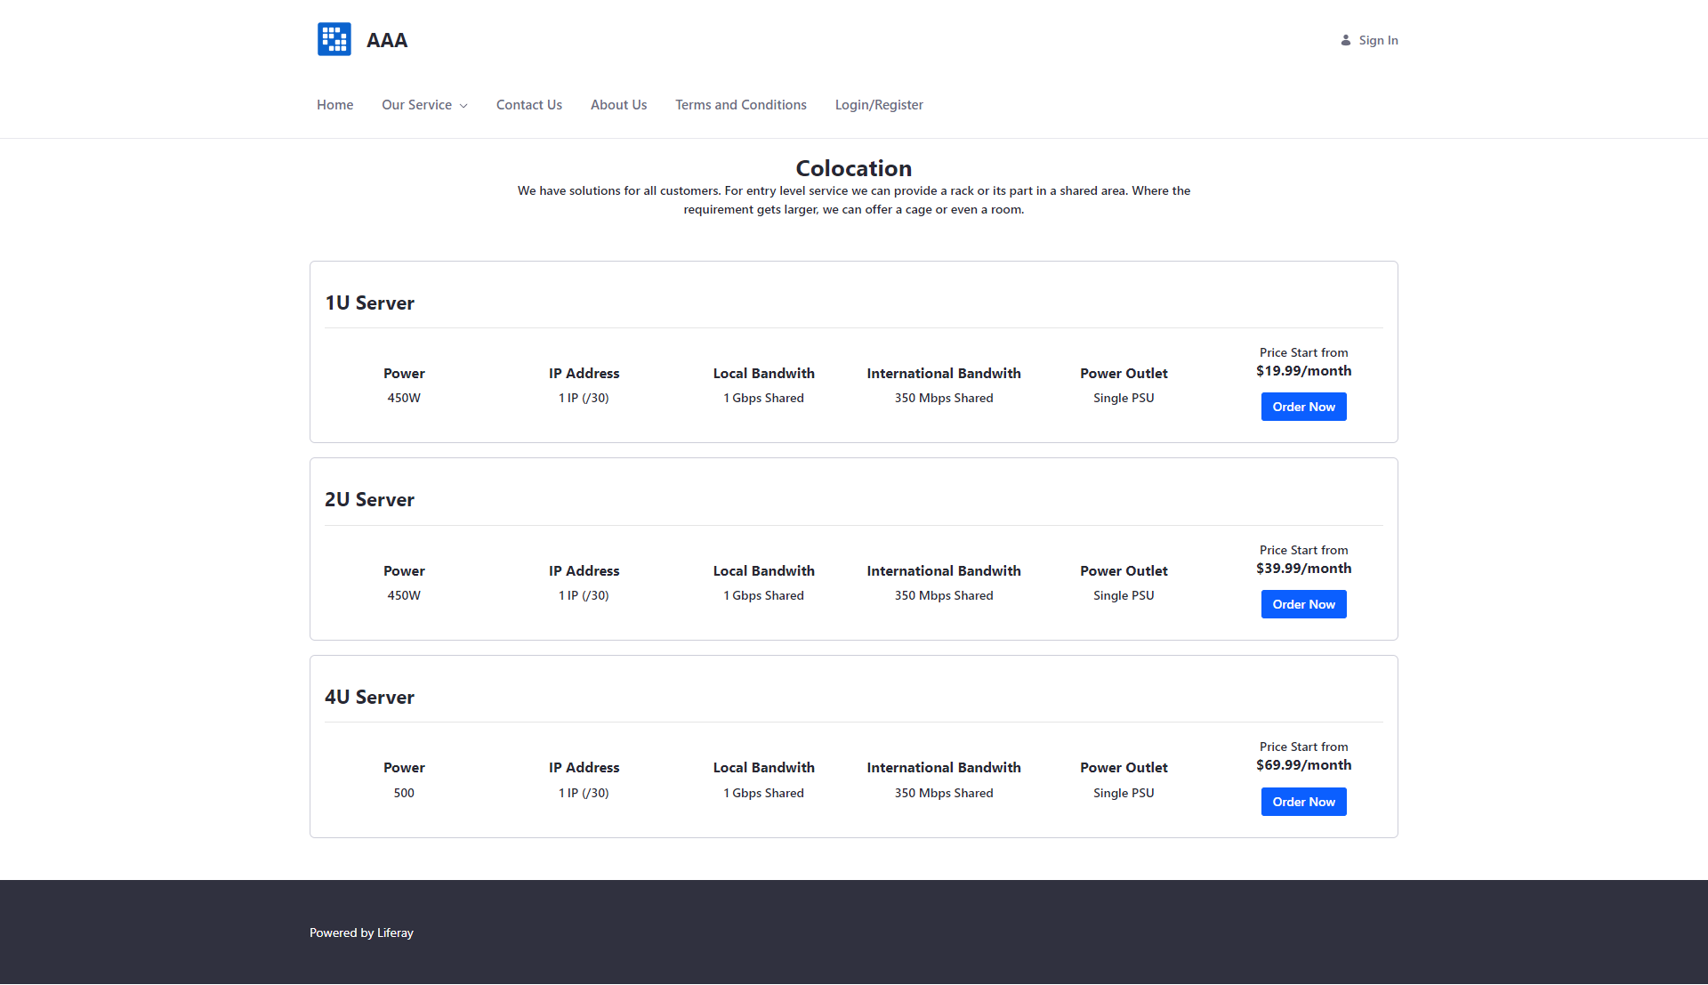
5. Developing Triple A Portlet
Dedicated Hosting Service Page
Colocation Hosting Service Page

Slide 19
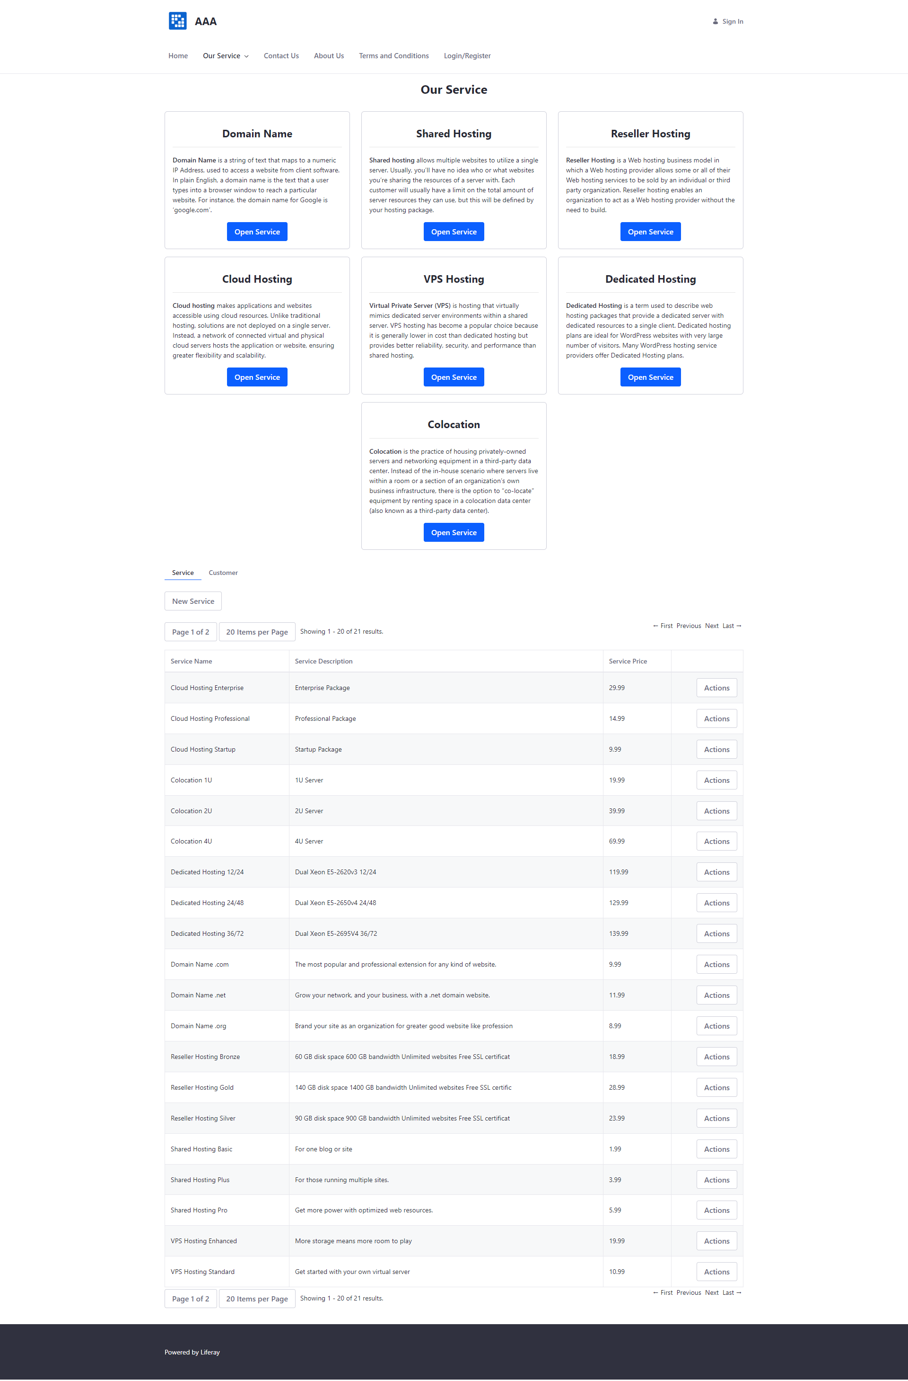
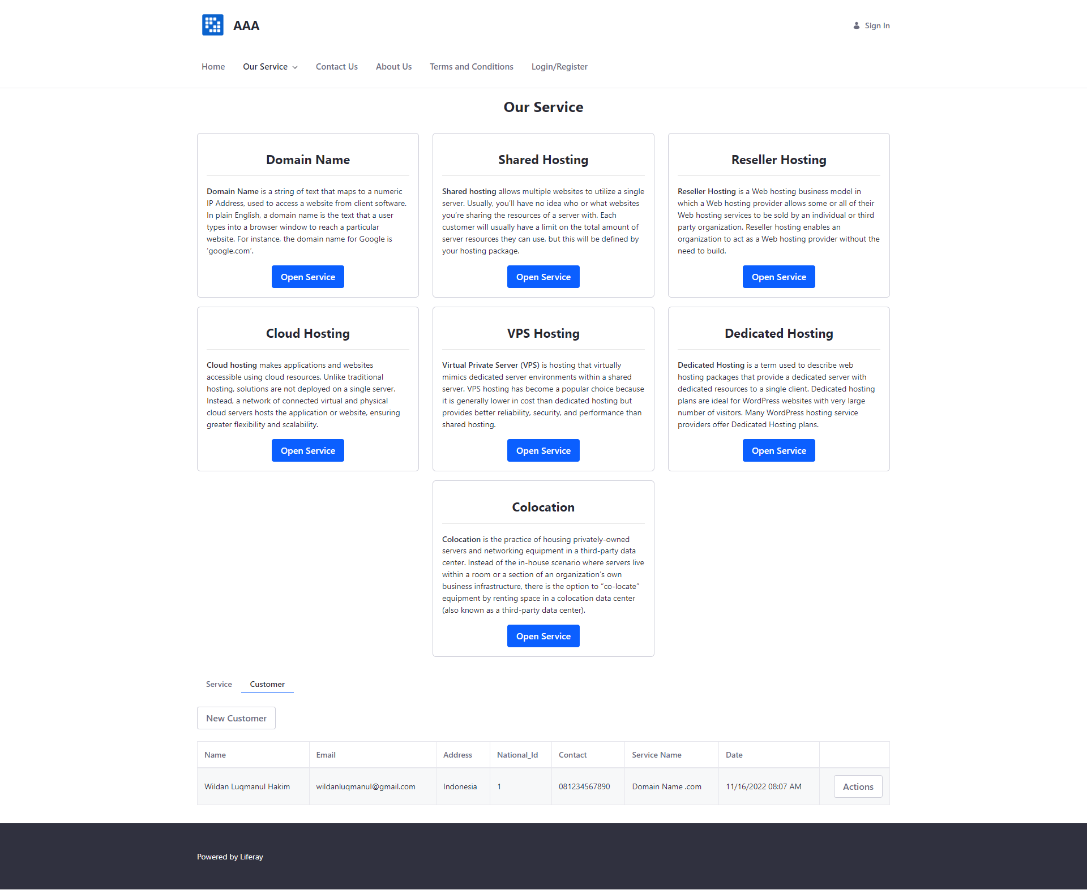
6. Customer Management Portlet
Service
Customer

Slide 20
7. Design Patterns
Design Pattern : Design pattern is a method created to assist the development team in finding solutions to common problems that arise when software development is in progress
Creational Design Pattern
Structural Design Pattern
Behavioral Design Pattern

Slide 21
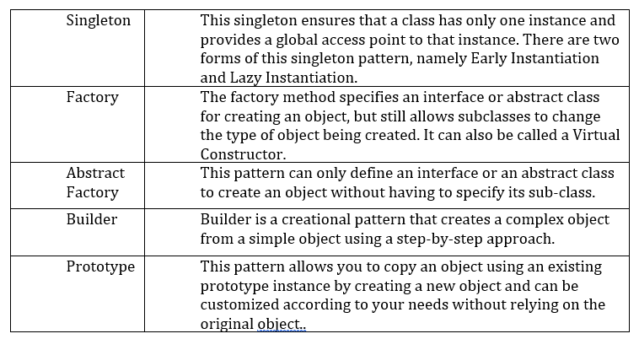
8. Creational Design Patterns
Creational design patterns are design patterns that deal with object creation mechanisms, trying to create objects in a manner suitable to the situation

Slide 22
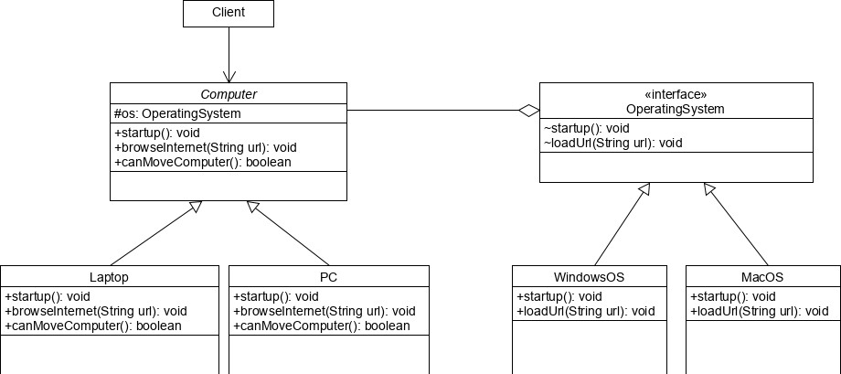
9. Structural Design Patterns
Structural Design Patterns are Design Patterns that facilitate design by identifying simple ways to realize relationships between entities

Slide 23
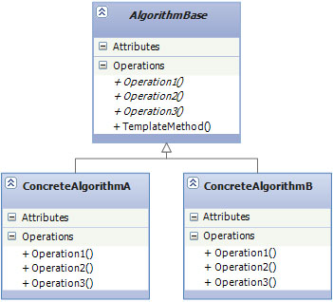
10. Behavioral Design Patterns
Behavioral design patterns are concerned with algorithms and the assignment of responsibilities between objects.
Template method / pattern
Observer method

